Slide 1


Summarizing Answer Graphs Induced by keyword Queries
Yinghui Wu (UCSB)

Slide 2


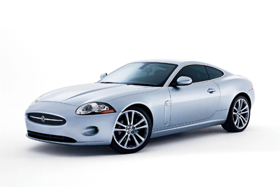




Keyword query over knowledge graph
  Searching big (graph) data with keyword query: too ambiguous!
Ambiguous!
Q = ‘Jaguar’, ‘America’, ‘history’
Jaguar XK 001
Jaguar XK 007
Jaguar XJ
Jaguar S type
…
_{Offer 1}
… Offer m
Ford, company
… Aspen, company
New York, city
…Chicago, city
New York, city
…Chicago, city
history
USA, country
USA, country
…
Black Jaguar
animal
White Jaguar
animal
South American Jaguars
history
history
habitat
history
Argentina
South America
continent
North America
continent
South America
continent
Keyword search is ambiguous over schema-less graphs

Slide 3
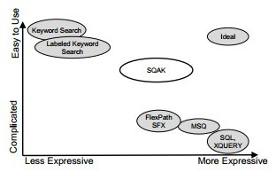
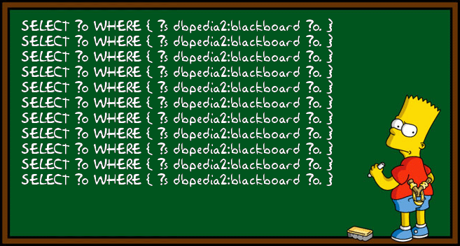
Graph queries?
Graph queries: Xpath, Xquery, SPARQL, regular path languages,...
- explicitly define relationships among keywords
- Higher expressive power, much lower usability!
- Complex syntax and grammar!
- Writing good queries require users to understand data beforehand!
Graph queries helps, but are too hard to write for end users

Slide 4


Graph Summarization
Ambiguous!
Q = ‘Jaguar’, ‘America’, ‘history’
Jaguar XK 001
Jaguar XK 007
Jaguar XJ
Jaguar S type
Black Jaguar
animal
White Jaguar
animal
_{Offer 1}
… Offer m
Ford, company
… Aspen, company
history
history
habitat
…
New York, city
…Chicago, city
New York, city
…Chicago, city
history
North America
continent
South America
continent
USA, country
USA, country
“A summary is worth a thousand words”
Car company
history
history
Americas,
continent
suggested
graph queries
city
USA, country
habitat
Idea: summarize answer graphs to suggest graph queries!

Slide 5
Outline
Searching big (graph) data
  keyword searching is ambiguous
  graph queries are good, but too hard to write for end users!
  Idea: use summaries of answer graphs to suggest graph queries
  Traditional (graph) compression and summarization do not work
Answer graph summarization
  “query-aware” summaries
  conciseness and coverage
  1-summarization, α-summarization, K summarization
  Experimental results
Conclusion

Slide 6
Keyword queries over graphs
Keyword query: a set of keywords Q(k1, … km)
A data graph: G = (V,E,L) of a set of labelled nodes and edges
Answering keyword query Q in G
  Q -> a set of answer graphs G =(G1, .. Gn) induced by Q in G
  Gi contains a set of keyword nodes corresponding to keywords in Q, and a set of intermediate nodes on the paths connecting two keyword nodes.
  Paths in Gi: connections /relationship of the keywords

Slide 7
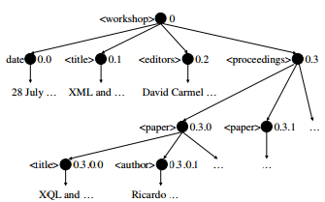
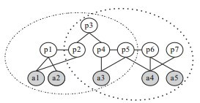
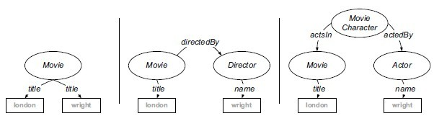
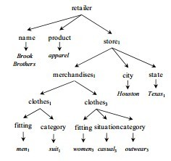
Result graphs: examples
“..Keyword search on graphs..”
Papakonstantinous
“workshop, paper, Ricardo”
(XRank, SIGMOD 03)
“Database, Papakonstantinous”
(EASE, SIGMOD 08)
“Texas apparel retailer '”
(“Query Biased Snippet Generation in XML Search”, SIGMOD 2008)
“wright london”
(“From Keywords to Semantic Queries”, Web Semant. 2009)
Keyword processing generates answer graphs

Slide 8





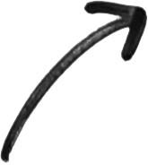
Keyword induced answer graph summarization
Query interpretation
Query transformation
graph queries
(SPARQL, pattern queries, XQuery…)
Keyword
queries
Keyword induced
query suggestion
Query refinement
Our work
Query evaluation
Result summarization
usability
expressiveness
Striking a balance between usability-expressiveness trade-off
Notes:
In one sentence, our work is to summarize intermediate results to help users to understand what they want and what they already got.
Summarizing answers induced by keywords to suggest queries!
Enhance search with structure
Improving result understanding
Effective query refinement/suggestion/expansion

Slide 9








Application: query suggestion/expansion
refined queries
Keyword query: “Jaguar”, “America”, “history”
Jaguar XJ
Jaguar S type
Black Jaguar
animal
White Jaguar
animal
Ford, company
… Aspen, company
history
history
habitat
New York, city
…Chicago, city
history
North America
continent
South America
continent
USA, country
Answer graphs
Suggested queries
Car company
history
history
Americas,
continent
Suggest
structured queries
habitat
city
USA, country
Answer graph summarization for keyword query suggestion

Slide 10
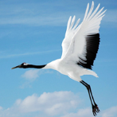
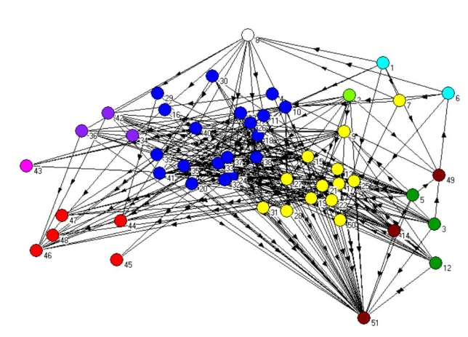
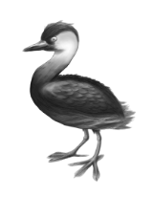
Application: result understanding
Q = “protected area, habitat, mammal, fish, bird”
“Show me the summary for bird, habitat and protected area.”
(Protected area)
Rara national park
Habitat
(South America)
bird (crane)
Habitat
(Burma)
bird (grebe)
Answer graph summarization for result understanding

Slide 11




Answer graph and summaries
An answer graph induced by Q
  keyword nodes and intermediate nodes
A summary graph Gs for a set of answer graphs G
  an abstraction that preserves pairwise connection relationships of keywords
  Each node is a group of keyword nodes or intermediate nodes
  For any path between two keyword nodes in Gs, there is a path with the same label connecting two keyword nodes in the union of answer graphs in G
Q: {Jaguar, USA, history}
answer graph
Jaguar XJ
Jaguar S type
Ford, company
… Aspen, company
New York, city
…Chicago, city
history
USA, country
a summary graph
company
history
city
USA, country
never suggest “false” paths!
Summarizing connection relationships among keywords

Slide 12
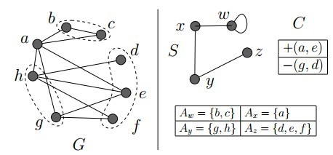
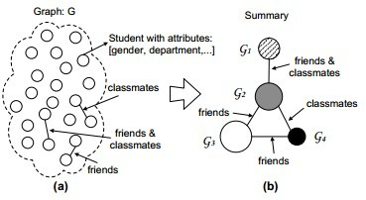
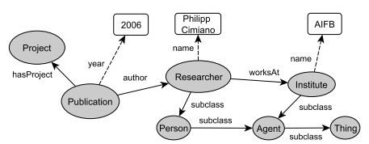
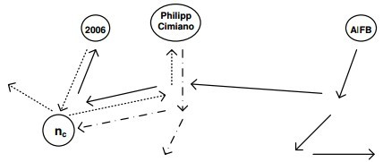
A comparison with graph summarization
“Graph Summarization with
Bounded Error”, SIGMOD 08
not “query-aware”!
“Efficient Aggregation for
Graph Summarization”,
SIGMOD 08
“Top K exploration of query
candidates for efficient keyword
search on graph-shaped data”,
ICDE 09
Require schema!
our summarization are keyword query-aware, requires no schema, and preserve path information without extra data structures
Traditional summarization do not work well for keyword query
Notes:
I will show the example later

Slide 13
Quality of a summary
Conciseness (summary size)
Coverage: α-summary, where α=2*M/(|Q|(|Q|-1), and M is the number of “covered” keyword pairs
  A keyword pair (k1, k2) in Q is “covered” by Gs if for every answer graph in G and every path between k1 and k2, there is a path of the same label in Gs
Jaguar XK 001
Jaguar XK 007
Jaguar XJ
Jaguar S type
_{Offer 1}
… Offer m
Ford, company
… Aspen, company
New York, city
…Chicago, city
New York, city
…Chicago, city
history
USA, country
USA, country
Car company
history
city
USA, country
Q={‘Jaguar, American, history’}
1-summary G_{s0}
offer
Quality: conciseness and information coverage

Slide 14
Example
Q = ‘a,c,e,f,g’
G1
a1*
a2*
G2
a3*
G3
a4*
b1
b2
d1
d2
d3
d4
d5
d6
…
d7
d8
d9
f1*
c1*
e1*
e1*
e2*
g1*
e3*
g2*
(‘a, c’), {G1, G2}
(‘a, e, g’), {G1, G2}
(‘a, e, g’), {G3}
a*
a*
a*
Bisimulation,
(R.Gentilini et.al, 2003)
can’t merge b1 and b2!
Error-tolerant and structure-based summary (R.Gentilini et.al, 2003)
Introduce “false paths”!
b
d
d
d
d
c*
e*
g*
e*
g*
0.3 -summary G_{s2}
G_{s3}
0.1-summary G_{s1}

Slide 15
Find Summary graphs with high quality
Minimum α-summarization: Given keyword query Q and its induced answer graph set G, identify a α-summary graph with minimum size
  special case: minimum 1-summarization
K summarization: Given Q, G and integer K, find a summary graph set Gs where (1) each summary graph in Gs is a 1-summary graph for a subset G_{i} of G, (2) all G_{i} forms a partition of G, and (3) the total size of summary graphs is minimized.
Problems | Complexity | Algorithms | Application
Minimum 1-summarization | PTIME | O(|Q|²|G|+|G|²) | Structured query suggestion, query expansion
Minimum α-summarization | NP-c | O(m||G|²) | Structured query suggestion, query expansion, result summarization
K-summarization | NP-c | O(I*K*|G_{m}|²+(|Q|²|G|+|G|²) | Result classification, result diversification, query expansion based on clustered results

Slide 16
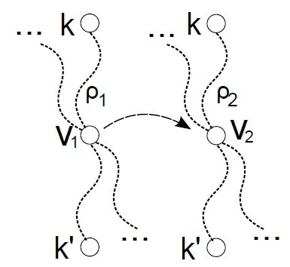
Compute 1-summary
Dominance relation R(k,k’)
  A binary relation over the nodes in an answer graph
  A pair of nodes (v1,v2) is in R(k,k’) iff they have the same label, and for any path between keyword nodes for k and k’ passing v1, there is a path of the same label between keyword nodes for k and k’ passing v2.
  A node v2 dominates v1 w.r.t a keyword pair (k,k’) if (v1, v2) is in R(k,k’); they are equivalent if they dominate each other
  Keyword nodes for the same keyword are always equivalent
a1*
a2*
b1
b2
d1
f1*
c1*
e1*
R(a, c)

Slide 17

A sufficient and necessary condition
Given Q and G, a summary graph Gs is a minimum
1-summary graph for G and Q, If and only if
for each keyword pair (k,k’) from Q,
- for each intermediate node vs in Gs, there is a node [vs] in Gs;
- for any vi and vj in [vs], (vi, vj) is in R(k,k’);
- for any intermediate nodes vs1 and vs2 in Gs with same label and
any nodes v1 in [vs1], v2 in [vs2],
v1 and v2 do not dominate each other.
PTIME checkable
…
a*
a4*
G3
d
d4
d5
d6
d7
d8
d9
e*
g*
e3*
g2*
minimum 1-summary graph are essentially unique

Slide 18

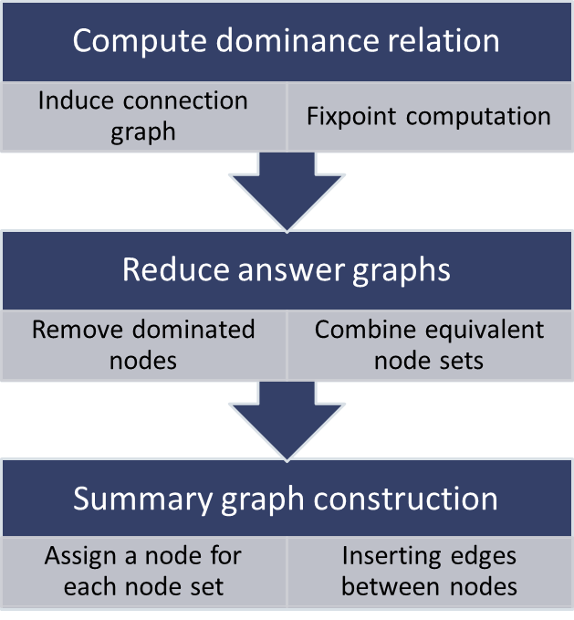
Computing minimum 1-summary
Subgraph induced by keyword pairs and paths connecting them
Q= “Jaguar”, “America”, “history”
Jaguar XJ
Jaguar XJ
Jaguar S type
company
… company
offer
… offer
city
… city
history
city
… city
Node u is dominated by v for keyword pair in terms of path labels
USA, country
USA, country
Jaguar (car)
offer
company
city
history
USA, country
Computing summary graphs with minimum size

Slide 19

Compute α-summary
Minimum α-summary: a greedy heuristic
  computes connection graph induced by all keyword pairs
  Start with the minimum connection graph; each time select a keyword pair and its connection graph minimum merge cost (estimation of the increased size to the summary)
  Repeat until an α-summary is constructed
can be used to find a minimum α and summary for specified keywords
a1*
a2*
a3*
a*
a*
b1
b2
d1
d2
d3
b2
d1
d2
d3
f1*
c1*
e1*
e1*
e2*
g1*
a3*
a3*
a1*
a2*
a3*
e1*
e2*
g1*
d3
d3
b2
d1
d2
d3
0.3-summary (a,e,g)
(a,g)
g1*
+(e,g)
e2*
g1*
+(a,e)
e1*
e1*
e2*
g1*
trade-off between information coverage and summary size

Slide 20
Computing K summary
  Minimum K-summary: a K-center clustering process
  Initializes K “center” answer graphs
  Iteratively refines K cluster by merging answer graphs with minimum estimated merge cost until convergence
  Computes K summary graphs for each cluster
a1*
a2*
G1
G2
a3*
G3
a4*
{
}
{
…
}
b1
b2
d1
d2
d3
d4
d5
d6
d7
d8
d9
f1*
c1*
e1*
e1*
e2*
g1*
e3*
g2*
a*
a*
{
}
{
}
b1
b2
d1
d
2 summary
f*
c*
e*
e*
g*
trade-off between information coverage and summary size

Slide 21
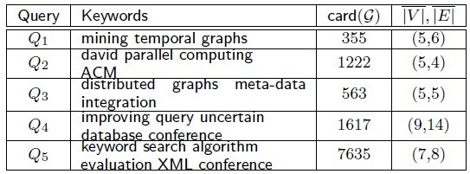
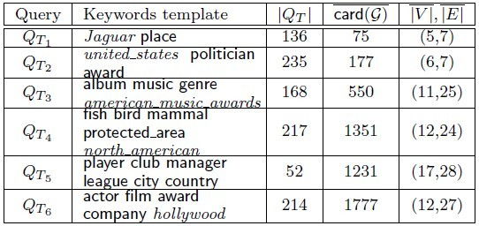
Experimental study
Datasets:
  DBLP with 2.47 million nodes and edges, with 24 labels (types);
  DBpedia with 1.2 million nodes and 16 million edges, with 122 types;
  YAGO with 1.6 million nodes and 4.48 million edges, with richer schemas: 2595 types
Answer graph generation:
  Keyword search algorithms from
    “Bidirectional expansion for keyword search on graph databases”, VLDB 2005
    “Ease: an effective 3-in-1 keyword search method for undstructed, semi-structured and structured data, SIGMOD 2008”

Slide 22
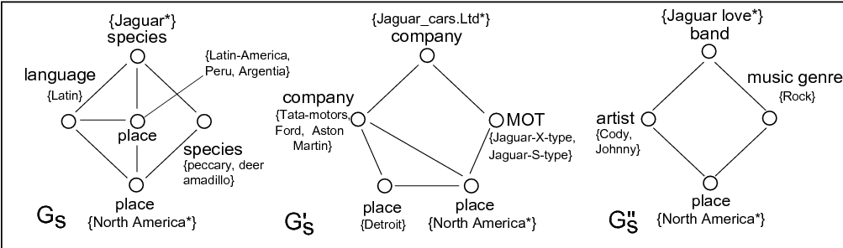
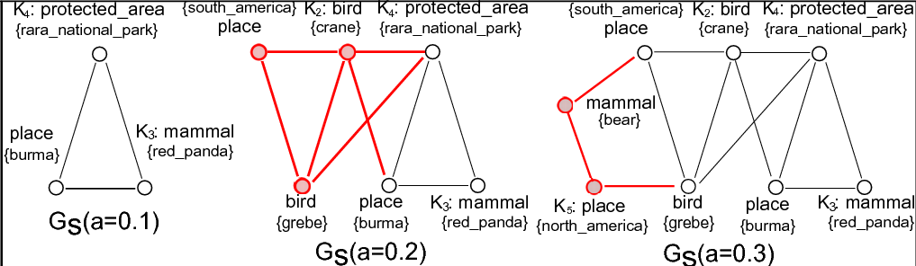
Experimental study: effectiveness
Query: “Jaguar”, “North America”
Suggested queries:
“interesting”
expansion
query suggestion with good information coverage (67% path labels, α=0.3)
Notes:
One mentionable thing is that the technique can be readily extended for any specific keyword set from the query.

Slide 23
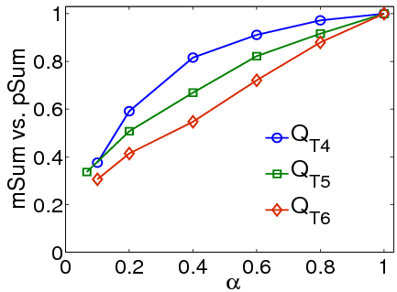
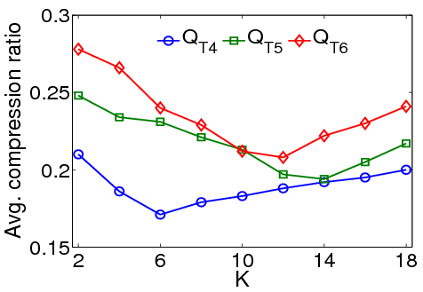
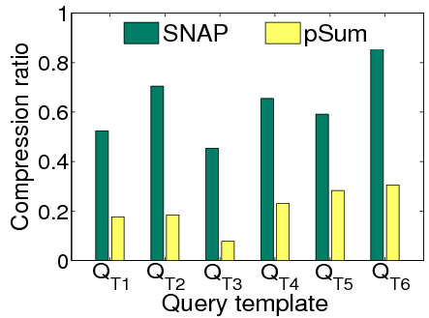
Experimental study: effectiveness
Significantly compress the original graphs with good coverage ratio

Slide 24
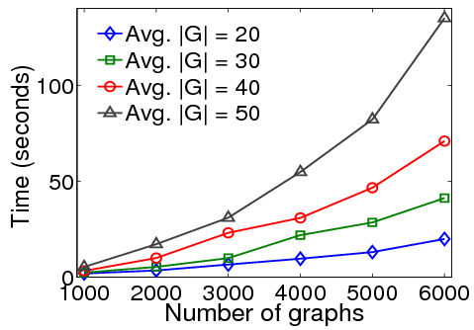
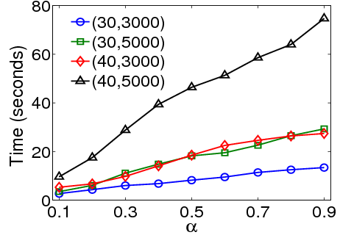
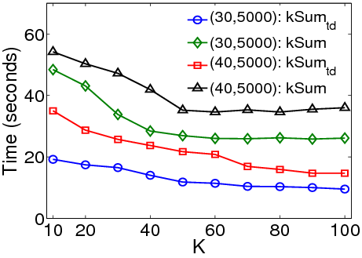
Experimental study: efficiency
Efficient in general, and scale well with the number of graphs, coverage requirement and partition size

Slide 25
Conclusion
New challenge for keyword searching over knowledge graph
  keyword querying is ambiguous!
  graph queries are more specific, but are hard to write!
Idea: (graph) query suggestion and result analysis by summarizing answer graphs, induced by keywords
  Exact and heuristic algorithms for computing 1-summary, α-summary and K summary
  Application: query interpretation, result understanding and suggest an interactive keyword searching framework

Slide 26
Future work
  Consider keywords of different weights or “interestingness”
  Performance guarantees on summary quality and improved efficiency
  Enhance keyword search with summary structures

Slide 27


Resources
All of projects will be announced in this link: http://grafia.cs.ucsb.edu/
- Ontology-based subgraph matching
  http://grafia.cs.ucsb.edu/ontq
-Ness and Nema
  http://habitus.cs.ucsb.edu/SIGMOD11_Ness.tar.gz
  http://habitus.cs.ucsb.edu/VLDB13_NeMa.tar.gz
-Sedge:
  http://grafia.cs.ucsb.edu/sedge/
Acknowledgement:
  Information Network Science CTA, ARL
  Our group: Xifeng Yan, Shengqi, Fangqiu Han…

